Slide 1
How to Handle Uncomfortable Situations Effectively
Michael Gregory
651-633-5311
mg@mikegreg.com

Slide 2
Big Picture
Define collaboration and The Collaboration Effect®
Explore connecting relationships, listening actively, and educating judiciously
Have greater focus, control, and peace in their professional and personal relationships
Apply the listening technique to take positive actions going forward
Reference The Collaboration Effect® Pocket Guide

Slide 5
It’s not about me It’s all about we It starts with me
Notes:
The message for today is – It’s not about me

Slide 6
The Collaboratin Effect
Connecting Relationships
Listening Actively
Educating Judiciously
Leads to Building Bridges and Negotiating Closure

Slide 7
Question 1
The Collaboration Effect does NOT include
A. Connecting Relationships
B. Listening Actively
C. Educating Judiciously
D. Intimidating Others

Slide 8
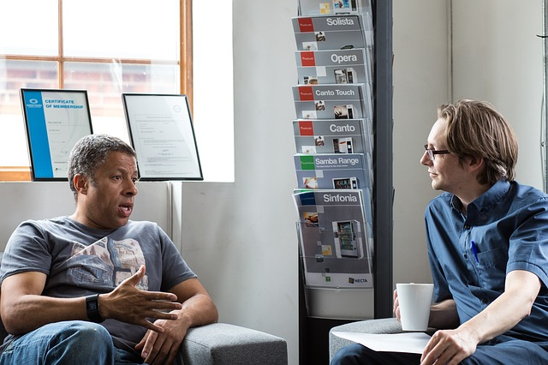
Today’s Focus
Brief Introduction
with an example of
listening actively

Slide 9
Collaboration
the action of working with someone to produce or create something

Slide 10
Collaboration

Slide 11
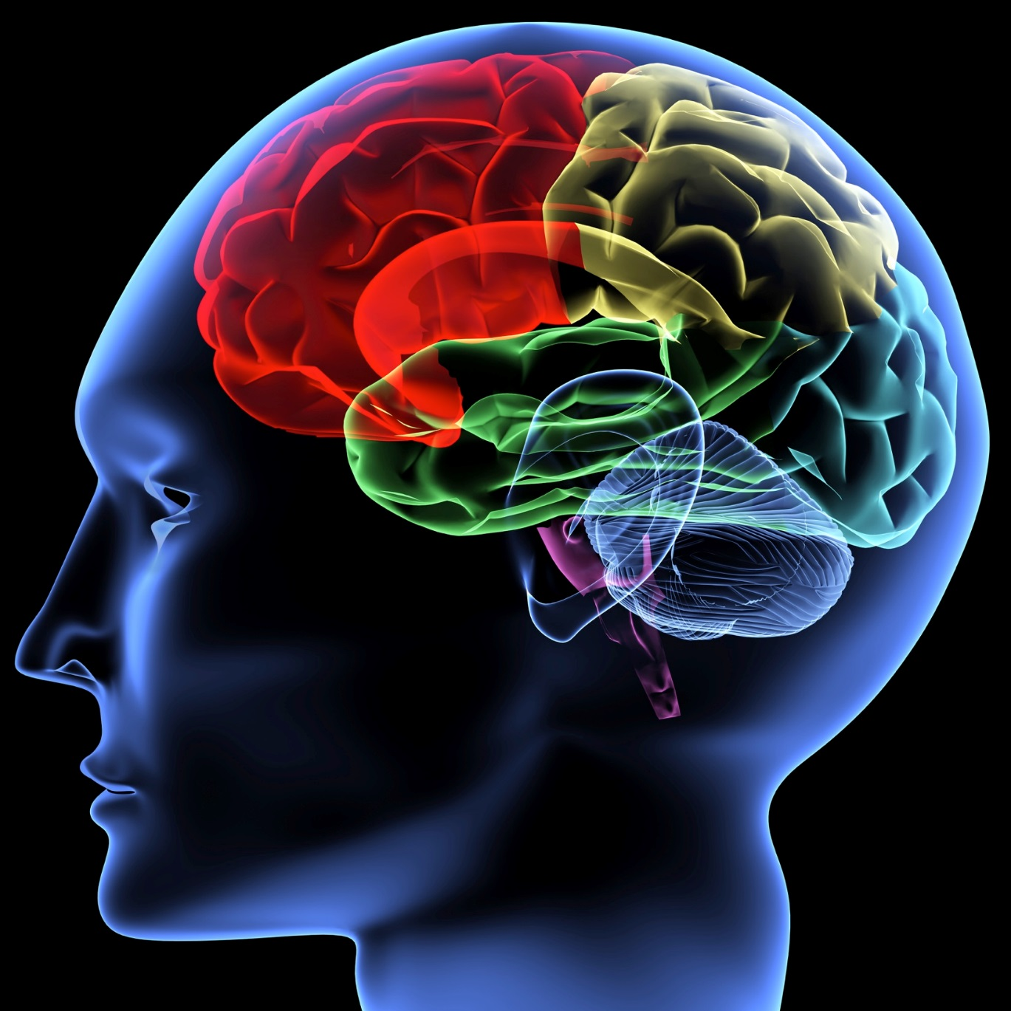
Thanks, Neuroscience!
Terry Wu, PhD Vanderbilt Neuroscientist
Ericka Garms, PhD U of MN and Her Team, Neuroscientist
John B. Molidor, PhD Assoc. Dean MSU Medical School
Rick Hanson, PhD Psychologist, Greater Good U of CA Berkeley
Notes:
5/15/10
Mindfulness
More sleep
The right foods
Three keys
Attention and focus
Priorities
Energy – Resources
SCARF Model
Status
Certainty
Autonomy
Relatedness
Fairness
Greater Good In Action

Slide 12
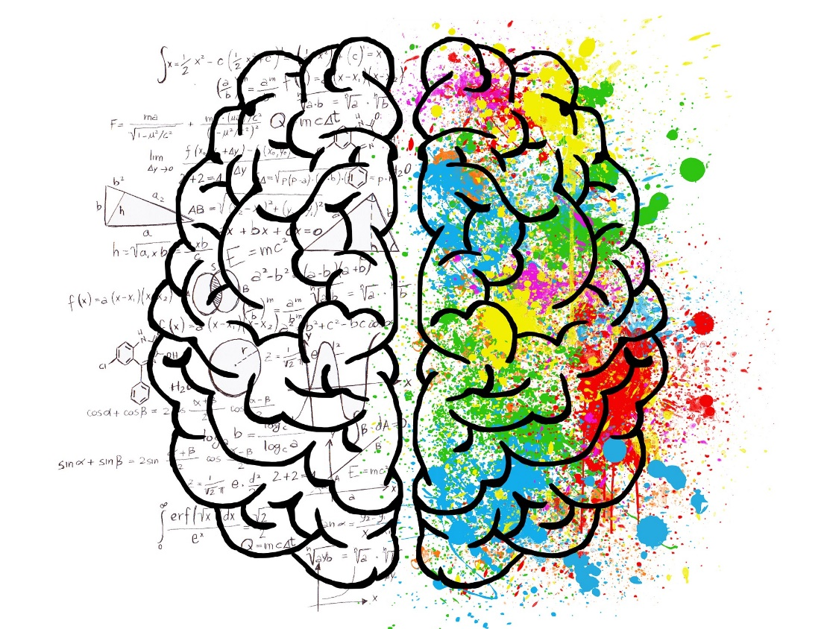
The Brain is Out to Protect Us
The brain is lazy – chooses least energy approach
The brain predicts continuously based on the past
Our brain has two hemispheres that are gated
Right hemisphere is more big picture, left more detail oriented – brain likes big picture first.

Slide 13
Question 2
The brain is basically lazy
A. True
B. False

Slide 14
Connections in the Brain
Neurons likes superhighways
As we age – tune and prune dendrites
Tapping into existing memories can drive positive current actions
Reflexes from habits and goals
Notes:
Note that habits become reflexes
Biases take almost no thought
If think of something and start it, in 20 to 30 seconds we are more likely to accomplish the task

Slide 15
What Can You Do to Help Your Brain?
Eat more plant-based foods – antioxidants (blue berries), dark green, and orange colors best – you are what you eat (100,000 neurons in your gut)
Drink more water
Never stop moving (get appropriate exercise)
Have consistent sleep patterns – consistent wake up time - MOST IMPORTANT of first four elements
Mindfulness at least 10 minutes a day

Slide 16
Working with Others
Under 25 and Over 25
Neuroplasticity – only organ to wire and rewire itself
Continually exploring
Senses
Perceptions
Feelings
Thoughts
Behaviors
Biases are received informally and behave externally

Slide 17
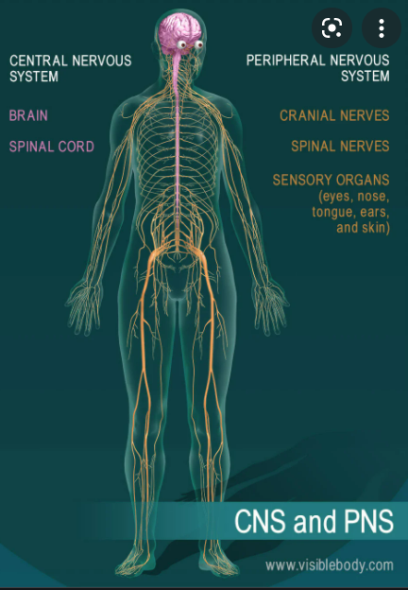
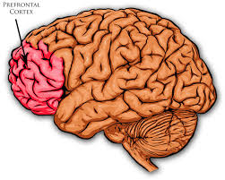
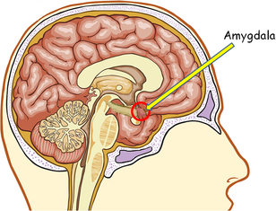
Nervous System, Amygdala, and Prefrontal Cortex
Notes:
Cortisol
Dopamine
Endorphins
Oxytocin
Serotonine
70% of people are visual learners – high fidelity
Lisa Feldman Barrett “How Emotions Are Made: The Secret Life of the Brain” and “7 ½ Lessons About the Brain”
Suggestions for increasing emotional intelligence that Barrett proposes include: (1) learning new words and emotional concepts, (2) learning how to categorize emotional instances with more granularity; seeing the 37 shades of anger, (3) keeping track of positive experiences so you can recognize them with more sensitivity in the future and access those more readily, (4) deconstructing an emotional instance into the affective feeling of the mere physical sensations and using those to reframe the moment from a broad label to a more nuanced understanding of the moment.

Slide 18
Notes:
Beliefs Cannot Be Changed - Work Towards Common Values
Reframing and Summarizing Engage Cognitive Operators

Slide 19
You Can’t Push a Rope; You Can Only Pull a Rope

Slide 20
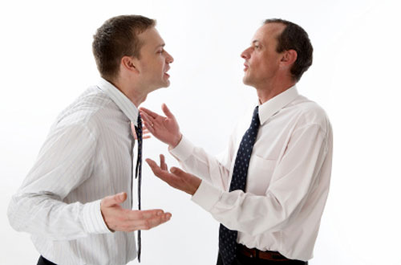
Escalation
Notes:
Escalation increases negative emotional response
De-escalation increases neutral emotional response
Fields of neuroscience, social work and hostage negotiation

Slide 21
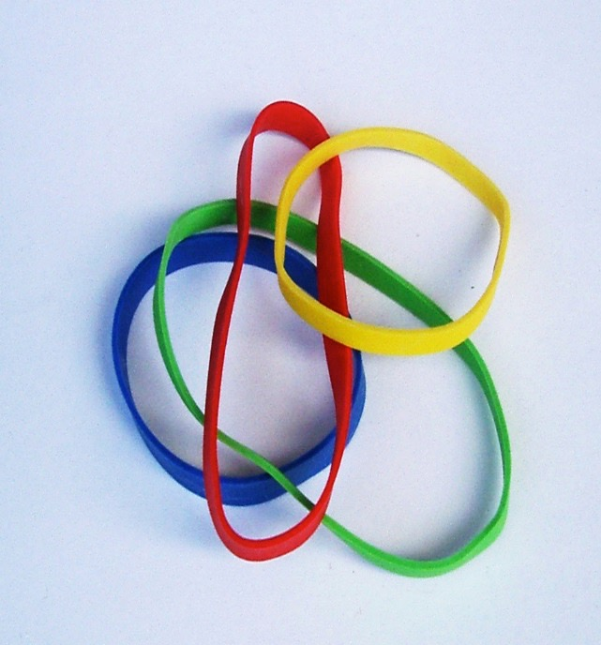
Neuroplasticity – Ability to Change
Notes:
Neuroplasticity
Ability to change
We all can learn
Based on what we tell ourselves
Happiness
Gratefulness
Label Negative Feelings
Make the decision good enough 80-20
Hugs – Touch People
Mindfulness – meditation, prayer, reflection, yoga

Slide 22
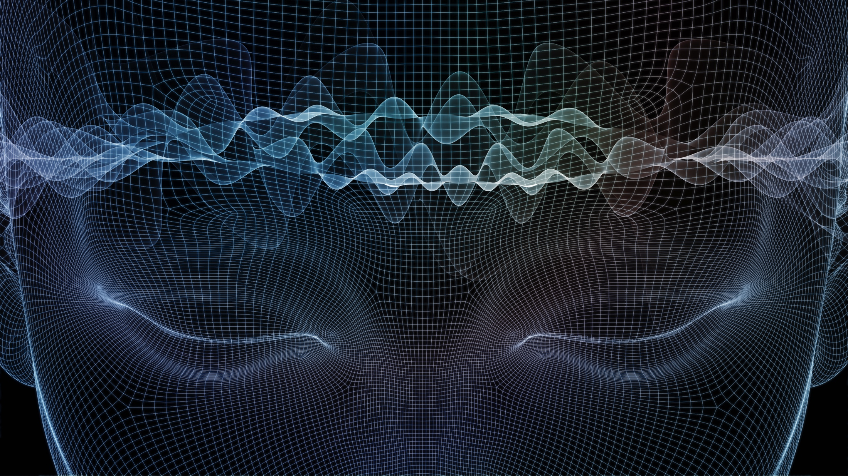
Emotions
Priorities
Impacts
Notes:
We are 98% emotional and 2% rationale
Work on emotion first
We are predisposed to judge negatively first
We hard wired to approach for food, shelter and sex
We tend to defend against everything else

Slide 24
Notes:
Three sides to an issue: my side, your side and the truth
Issue resolution
Emotional
Factual
How can I help bring peace to those in conflict?

Slide 25
Communication
Notes:
Communication
Attitude
Experts communication and attitude
10% words, 35% tone, 55% body language
Albert Mehrabian
55% body language
37% tone
8% words
Mehrabian Weiner and Ferris communication and attitude
40% vocal and 60% facial

Slide 26
Question 3
In general, the attitude in communication is determined 7% by the words, 38% by the tone, and 55% by facial expression and body language.
True
False

Slide 27
Listening Actively…
Notes:
What are barriers to Listening?
How do you overcome them?
Active listening
Discuss and define
Practice an example
Ask how it felt
Men versus women
Differences
Approaches

Slide 28
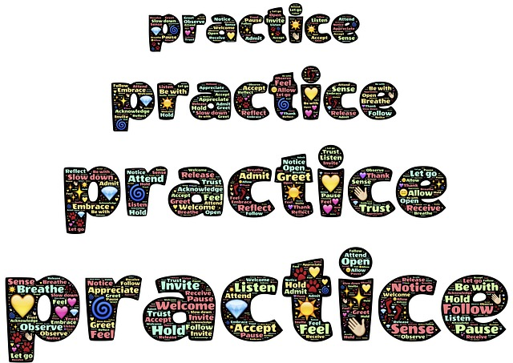
Listening Exercise
Paraphrase
Ask open ended questions
Summarize
Suspend judgement
Empathize
Do not offer advice
The Acronym is PASSED
Follow Up – Check for Understanding

Slide 29
Practical Advice for All Leaders
Catch your employees doing something right at least one a week and thank them for it (something specific)
Get them the resources they need from their perspective and don’t micromanage
Give them a chance to shine in leadership and accomplishment

Slide 30
Lead with Compassion Listen with Empathy
Compassion
Prefrontal Cortex
Empathy
Cerebral Cortex
Calm
Confident
Competent
Understand Their Feelings
Feel their Pain
Take Actions to Address Pain

Slide 31
Question 4
Being empathetic means being
A. Indifferent
B. Insensitive
C. Apathetic
D. Understanding

Slide 32
The Collaboration Effect
Connecting Relationships
Listening Actively
Educating Judiciously
Leads to Building Bridges and Negotiating Closure

Slide 33
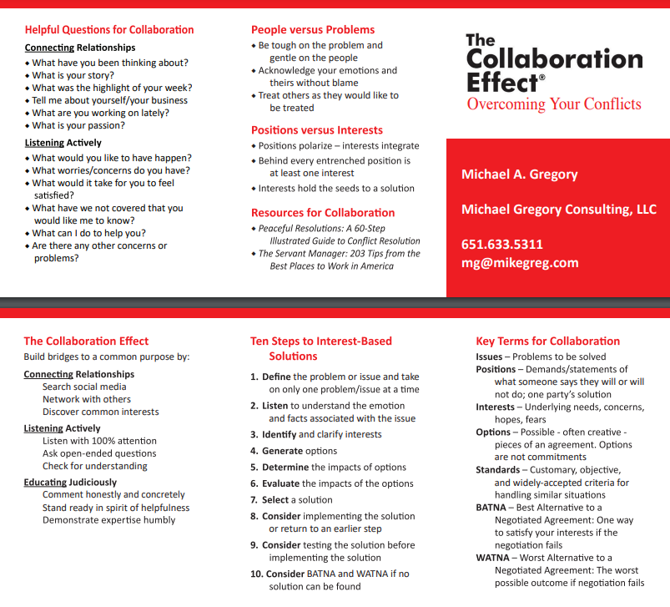

Slide 37
Three Part Process to Get What You Want
You have to decide what you want
You have to ask for it
You have to give three reasons why this is beneficial for them
THEN BE quiet AND LISTEN

Slide 38
Yale University’s Most Popular Class – Happiness - Neuroscience
Gratitude 5 minutes a day
Label negative feelings
Know you made the best decision you could
Appropriate touch with others
Mindfulness 10 min. daily

Slide 39
Reduce the Stress Response in Yourself and Others
Maintain a sense of control
Embrace predictability (routines and rituals)
Appreciate your progress (break big project into small bites)

Slide 40
It’s not about me It’s all about we It starts with me
Notes:
The message for today is – It’s not about me

Slide 41
Big Picture
Define collaboration and The Collaboration Effect®
Explore connecting relationships, listening actively, and educating judiciously
Have greater focus, control, and peace in their professional and personal relationships
Apply the listening technique to take positive actions going forward
Reference The Collaboration Effect® Pocket Guide

Slide 42
Go Over the Participants Summary

Slide 43
How to Handle Uncomfortable Situations Effectively
Michael Gregory
651-633-5311
mg@mikegreg.com

