Slide 1



Estate Planning 201
Alphabet Soup of
Estate Planning
Travis Bigler, CPA, MST
Keith Harder, CFP, NQPA

Slide 2
Learning Objectives
Define estate planning
The impact of the December 31, 2025, sunset on the exemption for our clients
Identify key estate planning strategies using various trusts
Team resources
  Tax
  Insurance
  Legal
  Investment
Notes:
Cathy to start

Slide 3

WHAT IS ESTATE PLANNING?
Notes:
Cathy to begin…

Slide 4
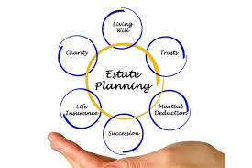
Estate planning is the process by which an individual or family arranges for the transfer of assets in anticipation of death. An estate plan aims to preserve the maximum amount of wealth possible for the intended beneficiaries and flexibility for the individual prior to death.
Notes:
Cathy
Read definition
One of the keyways to preserve the maximum amount of wealth is to minimize the amount of estate tax paid – remember that your gross estate includes everything you own….
your car, home, other real estate, checking and savings accounts, investments, furniture, personal possessions.
This can be confusing for some of our clients..
One client wasn’t aware that their revocable trust would be included in their gross estate..they were confused and thought by avoiding probate the assets transferred to the trust were no longer part of their “estate” subject to tax.
Mark, how about you?

Slide 5
Common Estate Planning Goals
Providing for Loved Ones
Mitigating or Avoiding Probate
Minimizing Taxes
Providing for Orderly Administration & Stewardship of Property
Protecting Assets
Providing for Incapacity
Notes:
Cathy

Slide 6

TITLE GOES HERE
ESTATE PLANNING DOCUMENTS
Notes:
Lead Q. to Mark
Mark, what are the estate planning must haves our clients should have in place?

Slide 7
Estate Planning Must-Haves
Last Will and Testament
Trust Document
Durable Power of Attorney (POA)
Healthcare Power of Attorney (POA)
Advance Healthcare Directive/Living Will
Beneficiary Designations
  Life Insurance
  Annuities
  Retirement Benefits
Notes:
Mark

Slide 8
Will vs. Trust – What’s the difference?
A Will, also known as a Last Will and Testament, is a legally prepared and bound document that states your intentions for the distribution of your assets and wealth after your death. In the event you have children, a valid Will also allows you to designate who will care for them.
Like a Will, a Trust is a legal document that lets you distribute your possessions to people and organizations after you die. A Trust “owns” the property you put into it, while still allowing you to maintain control.
Main differences:
Wills allow for naming a guardian for minors/ Trusts do not
Wills take effect when you die/ Trusts take effect when signed and funded
Wills are subject to probate/ Trusts are not
Wills are public/ Trust are private
Notes:
Mark to discuss

Slide 9
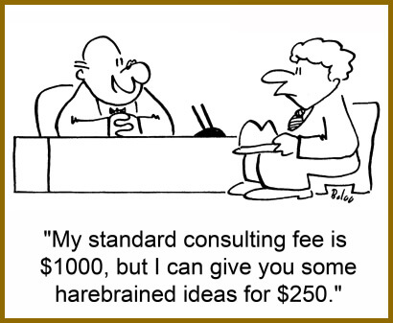
High net worth individuals should start planning for the potential sunset of existing estate tax limits on December 31, 2025. The so-called “Trump” tax law of 2017 set new higher limits, (approx. $12.9M for 2023), but with a catch—that all limits revert to prior law after December 31, 2025 ($5M, plus inflation adjustments).
For this sunset to be changed, Congress will have to act. And based upon recent political conflict within Congress, “action” has been extremely rare. If Congress does nothing, the reversion will occur. There is one more election cycle to go through in 2024, and those results could have significant effect on what Washington decides to do with this issue.
Plans today can allow a taxpayer to utilize the current higher exemption amounts, so that even if limits revert to lower limits, the current transfers are not subject to gift or estate tax. Transfers can be done in many ways. There are literally hundreds of combinations of planning devices that one could utilize with a wide range of complexity. Planning should take in account not only the size of one’s estate, and their family situations, but also the taxpayer’s appetite for complexity after the planning is executed.
Don’t let our clients be penny wise and pound foolish!
Notes:
Cathy to lead in
Mark to chime in on clawback
1.5 minutes

Slide 10
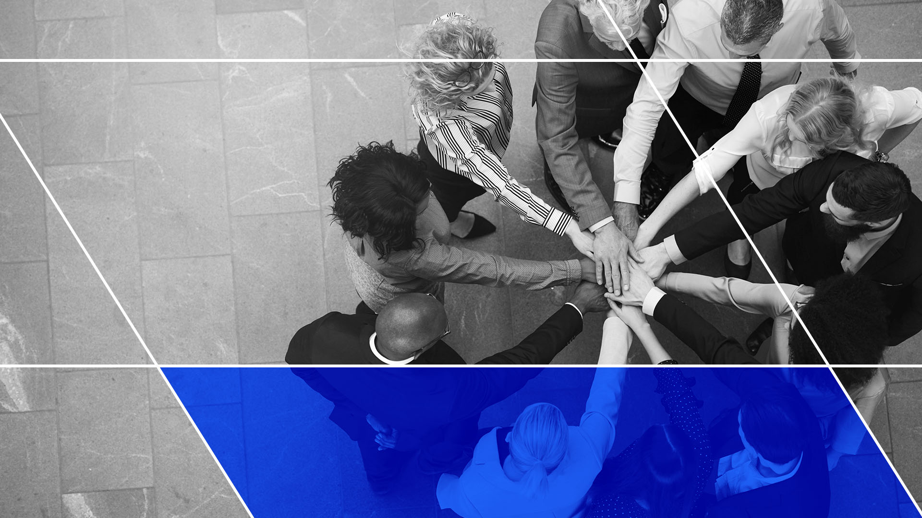
TITLE GOES HERE
Plan DON’T Predict

Slide 11
PLAN by reducing the Gross Estate (or increasing your applicable exclusion amount)
Annual Exclusion Gifts – Low Hanging Fruit
Trust Techniques – Let The Fun Begin!
IDIT – Intentionally Defective Irrevocable Trust
Sale and gifting
ILIT – Irrevocable Life Insurance Trust
CRT/CLT – Charitable Remainder/Lead Trusts
SLAT – Spousal Lifetime Access Trust
QPRT – Qualified Personal Residence Trust
$17,000 per person
Pay medical and educational expenses directly without using any exemption
Superfund 529 Plans
GRAT – Grantor Retained Annuity Trust
DSUE
Don’t forget the importance of portability and the impact the Deceased Spousal Unused Exemption can have
Notes:
Mark to speak – super brief on this slide since we dig in more on subsequent slides..
Lead to Cathy for portability example

Slide 12
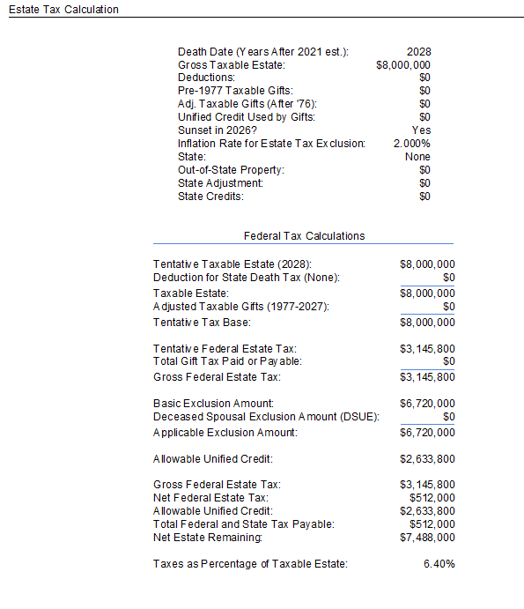
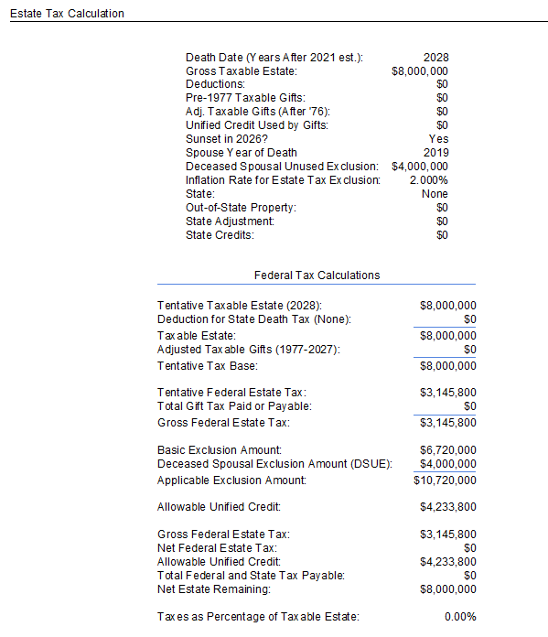
Let’s look at impact of not filing for DSUE..
Portability not elected
Portability elected
Notes:
Cathy slide 9 brief explanation of why planning is important
Impact of portability

Slide 13

Low hanging fruit or “freebies”:
An annual exclusion amount is how much a person can transfer to another without paying a gift tax; currently that amount is $17,000.
You can pay as much as you want toward medical or education…just remember it must be paid directly to the provider.
Don’t forget about superfunding those 529 plans. The IRS allows you to contribute up to $85,000 (the annual gift exclusion multiplied by 5) and treat the onetime contribution as being spread over five years for tax purposes.
Notes:
Cathy to do this slide and then pass to Mark
So now let the fun begin with various trusts that can be used in estate planning..

Slide 14
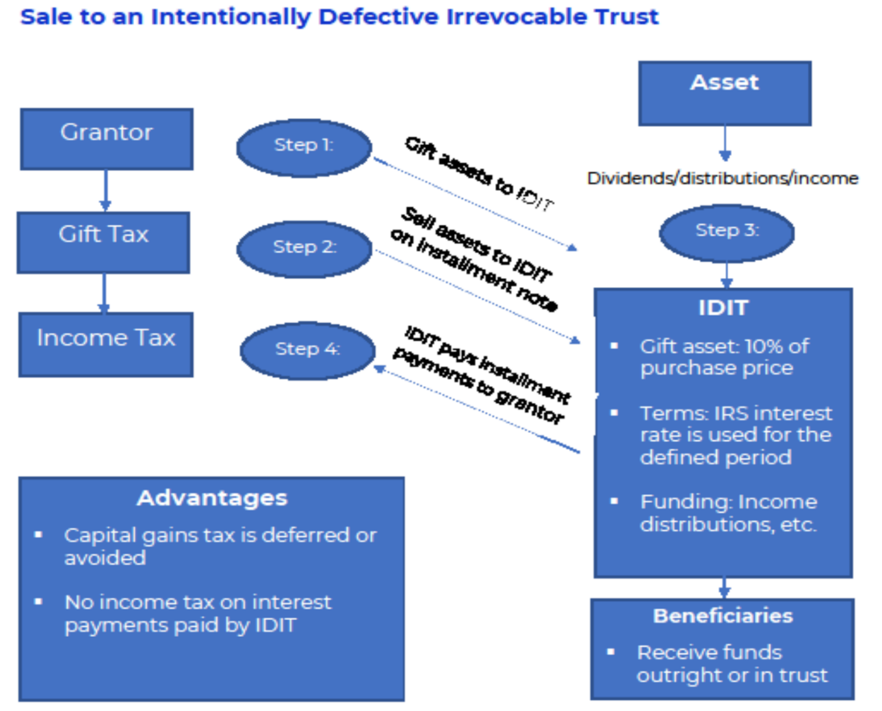
What is an Intentionally Defective Irrevocable Trust (IDIT)/ also know as Intentionally Defective Grantor Trust (IDGT)?
Pros:
Note terms are more favorable than a GRAT
Taxes paid by the grantor may be reimbursed sparingly
Cons:
May be challenging to find assets with sufficient cash flow
Notes:
Mark
Maybe begin with we will have examples at the end..

Slide 15
What is an Irrevocable Life Insurance Trust (ILIT)
GRANTOR(S)
Determines the terms of the ILIT and selects Trustee(s).
Policy is transferred into or purchased by the ILIT
ILIT
Policy(ies) are owned by and pay to the ILIT
Policy(ies) may insure one person or two.
Multiple policies may be owned by the same trust.
Trust provisions control the management / distribution of insurance policy proceeds.
A trust established to maintain a life insurance policy outside of the grantor’s taxable estate.
Pros:
Helpful with illiquid estates
Useful equalization tool for inheritance
Cons:
Sometimes administratively cumbersome – crummey notices
Policies are often “abandoned” and not regularly reviewed
GIFT / Estate Tax
INCOME TAX
Considerations
The policy death benefit will be includable in the grantor’s taxable estate if they don’t survive three years from the transfer date
A form 712 may be requested from the insurance company to determine gift value of a policy
* Watch out for “Unholy trinity” or “Goodman trap”.
** Be mindful of transfer for value rules
Notes:
Mark
Cathy to chime in on GST issues often missed when crummey is less than annual exclusion but doesn’t apply for GST..

Slide 16
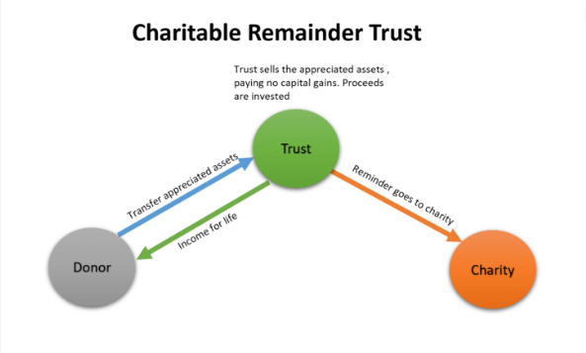
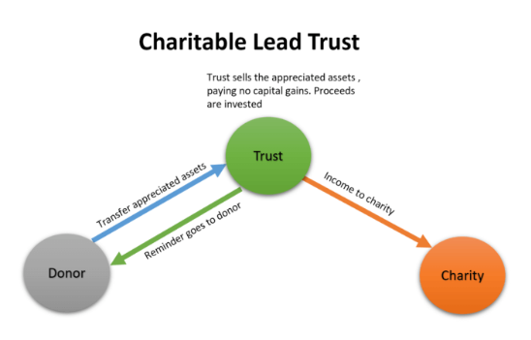
What is a Charitable Remainder (CRT)/Lead Trust (CLT)?
Two main types of CRTs
CRAT: A charitable remainder annuity trust pays donor a fixed dollar amount each year.
CRUT: A charitable remainder unitrust pays donor an annual % of the trust assets, valued annually.
CRTs are tax-exempt
PROS:
Immediate tax deduction for a portion of the value of the assets you transferred to the trust.
Tax on capital gains can be stretched out over several years and could escape income tax completely
Structure the trust to pay you (or your designated beneficiary) an income for life or a set term of years.
At the end of the payout period, the remaining assets in the trust distribute to one or more charities of your choice.
CONS:
The trust is irrevocable, so you cannot make changes after you fund it.
The payments you receive from the trust are taxable as income.
There is a risk that the trust’s assets will not perform as well as expected, impacting the amount of income you receive from the trust.
Two main types of CLTs
CLAT: A charitable lead annuity trust pays charity a fixed dollar amount each year.
CLUT: A charitable lead unitrust pays charity an annual % of the trust assets, valued annually.
CLTs are not tax-exempt and can be grantor or non-grantor like for income tax purposes.
PROS:
Makes regular charitable giving easy
Useful in reducing gift and estate taxes
Can provide an income tax deduction for the donor (needs to be grantor like for income tax purposes)
At the end of the payout period, the remaining assets in the trust distribute to family
CONS:
The trust is irrevocable, so you cannot make changes after you fund it.
Trust earnings may be taxed to the grantor
Charitable beneficiary unchangeable
* A separate presentation on charitable giving will be presented prior to year-end
Notes:
Cathy

Slide 17
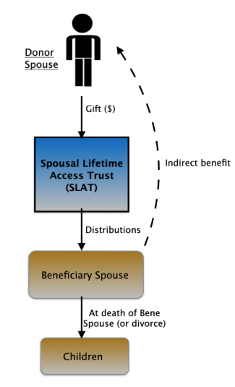
What is a Spousal Lifetime Access Trust (SLAT)?
A SLAT is an irrevocable trust created by one spouse for the primary benefit of the other spouse and, to the extent desired, the descendants of either or both spouses.
Pros:
Take advantage of utilizing the donor spouse's gift and estate tax exemption to shift assets out of the taxable estate, while still allowing the beneficiary spouse and descendants access to those funds.
Cons:
Tradeoffs with respect to basis step-up at death
Risk of death or divorce of the non-donor spouse
Notes:
Cathy

Slide 18
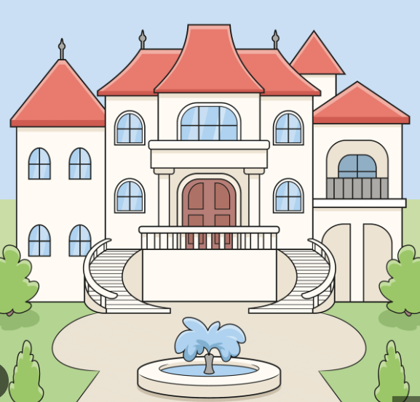
What is a Qualified Personal Residence Trust (QPRT)?
A QPRT is an irrevocable trust by which you, as the grantor, transfer ownership of your home while retaining the right to live there for a specified number of years. When that term of years expires, ownership of the home passes to the remainder beneficiaries outright or in continued trust. You may continue to live in the house after the expiration of the term, but you must enter into a formal written lease and pay fair market value rent to the new owner.
Pros:
Reduces estate taxes by removing an appreciating asset from the donor’s taxable estate at a discount
Allows donor to retain property use
If donor continues to live in the home, rent payments can offer an additional path to transferring wealth
Cons:
Loss of step-up in basis
Possible loss of property tax benefits
Notes:
Cathy

Slide 19
What is a GRAT?
Transfer of assets
A GRAT is a trust established to transfer appreciation above the 7520 loan rate outside of the grantor’s taxable estate
Pros:
Can transfer appreciation of assets at minimal or zero gift tax value
Simple and low cost relative to other transfer techniques when publicly traded securities are used for funding
Cons:
No leverage for GST transfers
Full value of the trust is likely includable in the grantor’s estate if they don’t survive the term of the trust
Grantor
GRAT
Receive annuity payments
Gift Tax
Based upon present value of expected transfer. Often “zeroed out”
Beneficiaries -
Outright or in Trust
Income Tax
Grantor pays income tax on all of the GRAT income
Notes:
Mark I think we need to update this one on the pros and cons?
- MME Agreed! Thanks for the catch. These are updated now.

Slide 20
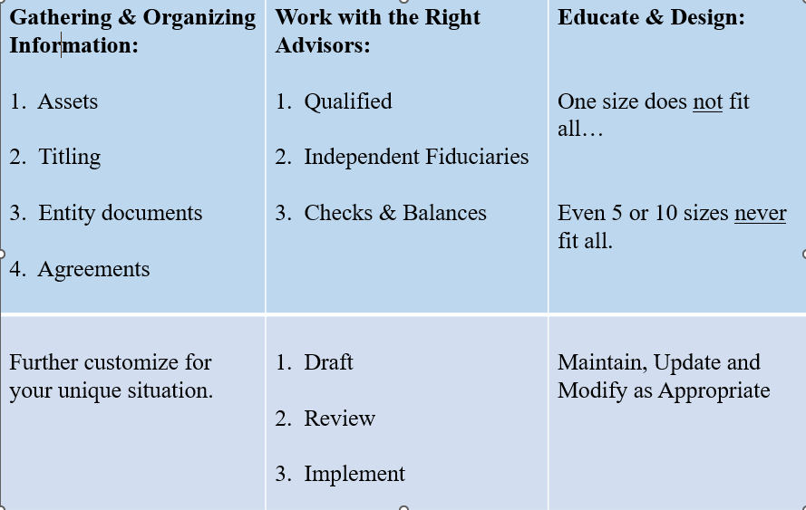
The Process
Notes:
Cathy

Slide 21

Example 1: Keep it Simple
QUESTIONS
Notes:
Cathy example :
Mark will run through the example… So Cathy, I have a client that has…..what type of planning might work best here? (include fact pattern on the slide)
Check in on timing..

Slide 22
Example Profile
Married clients in their 80’s
4 children all married
12 grandchildren
Ultra High Net Worth with no closely held businesses
Projected Estate Tax of approximately $21.5 million with no planning
Priorities
  Estate Tax Mitigation
  Passing wealth to Children/Grandchildren efficiently
  Protecting inheritance from unexpected events – divorce, substance abuse, creditor issues
Notes:
Mark

Slide 23
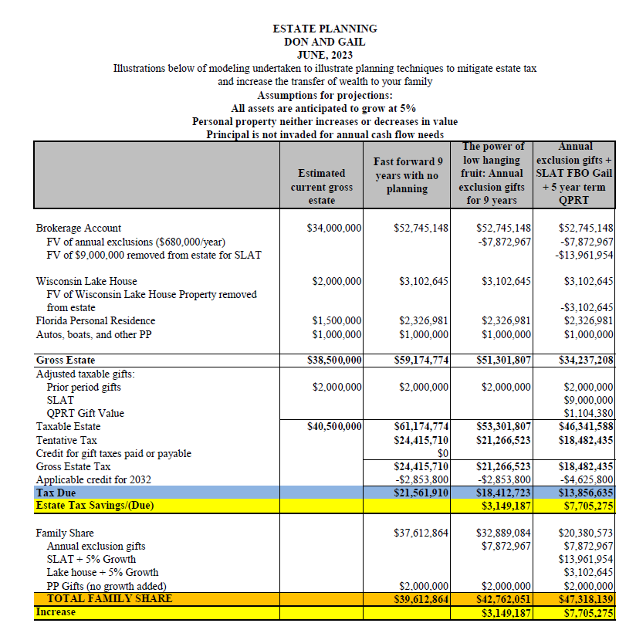

Slide 24
Example 2: Pump up the complexity
QUESTIONS
Notes:
Mark example :
Cathy will run through the example… So Mark, I have a client that has…..what type of planning might work best here? (include fact pattern on the slide)

Slide 25
Example Profile
Married clients in their 60’s
Ultra High Net Worth
Projected Estate Tax of approximately $68 million with no planning
Priorities
  Estate Tax Mitigation
  Passing wealth to Children/Grandchildren efficiently
  Protecting inheritance from unexpected events – divorce, substance abuse, creditor issues
Notes:
Mark

Slide 26
Solution:
Intentionally defective irrevocable trust (IDIT)
What is it?
  A trust that is “effective” at reducing estate taxes, yet “defective” for income tax purposes, meaning that any taxes due on income or property within the trust are taxed to the grantor.
  The trust property is not included in the value of the grantor’s estate, and does not receive a step up in basis.
  This structure maximizes the appreciation potential of the trust, because the trust is not paying taxes that drag on growth over time.
Notes:
Mark

Slide 27

Notes can be designed with flexibility in mind.
  Terms longer or shorter
  Interest only
  Private annuity (Increased cash flow)
  Self-canceling installment note (Use caution – Davidson)
No gain is recognized on the sale of the asset to the irrevocable trust.
The taxes paid on behalf of the trust may be viewed as a gift tax free transfer.
Notes:
Mark

Slide 28

A Word About Cash Flow

Slide 29
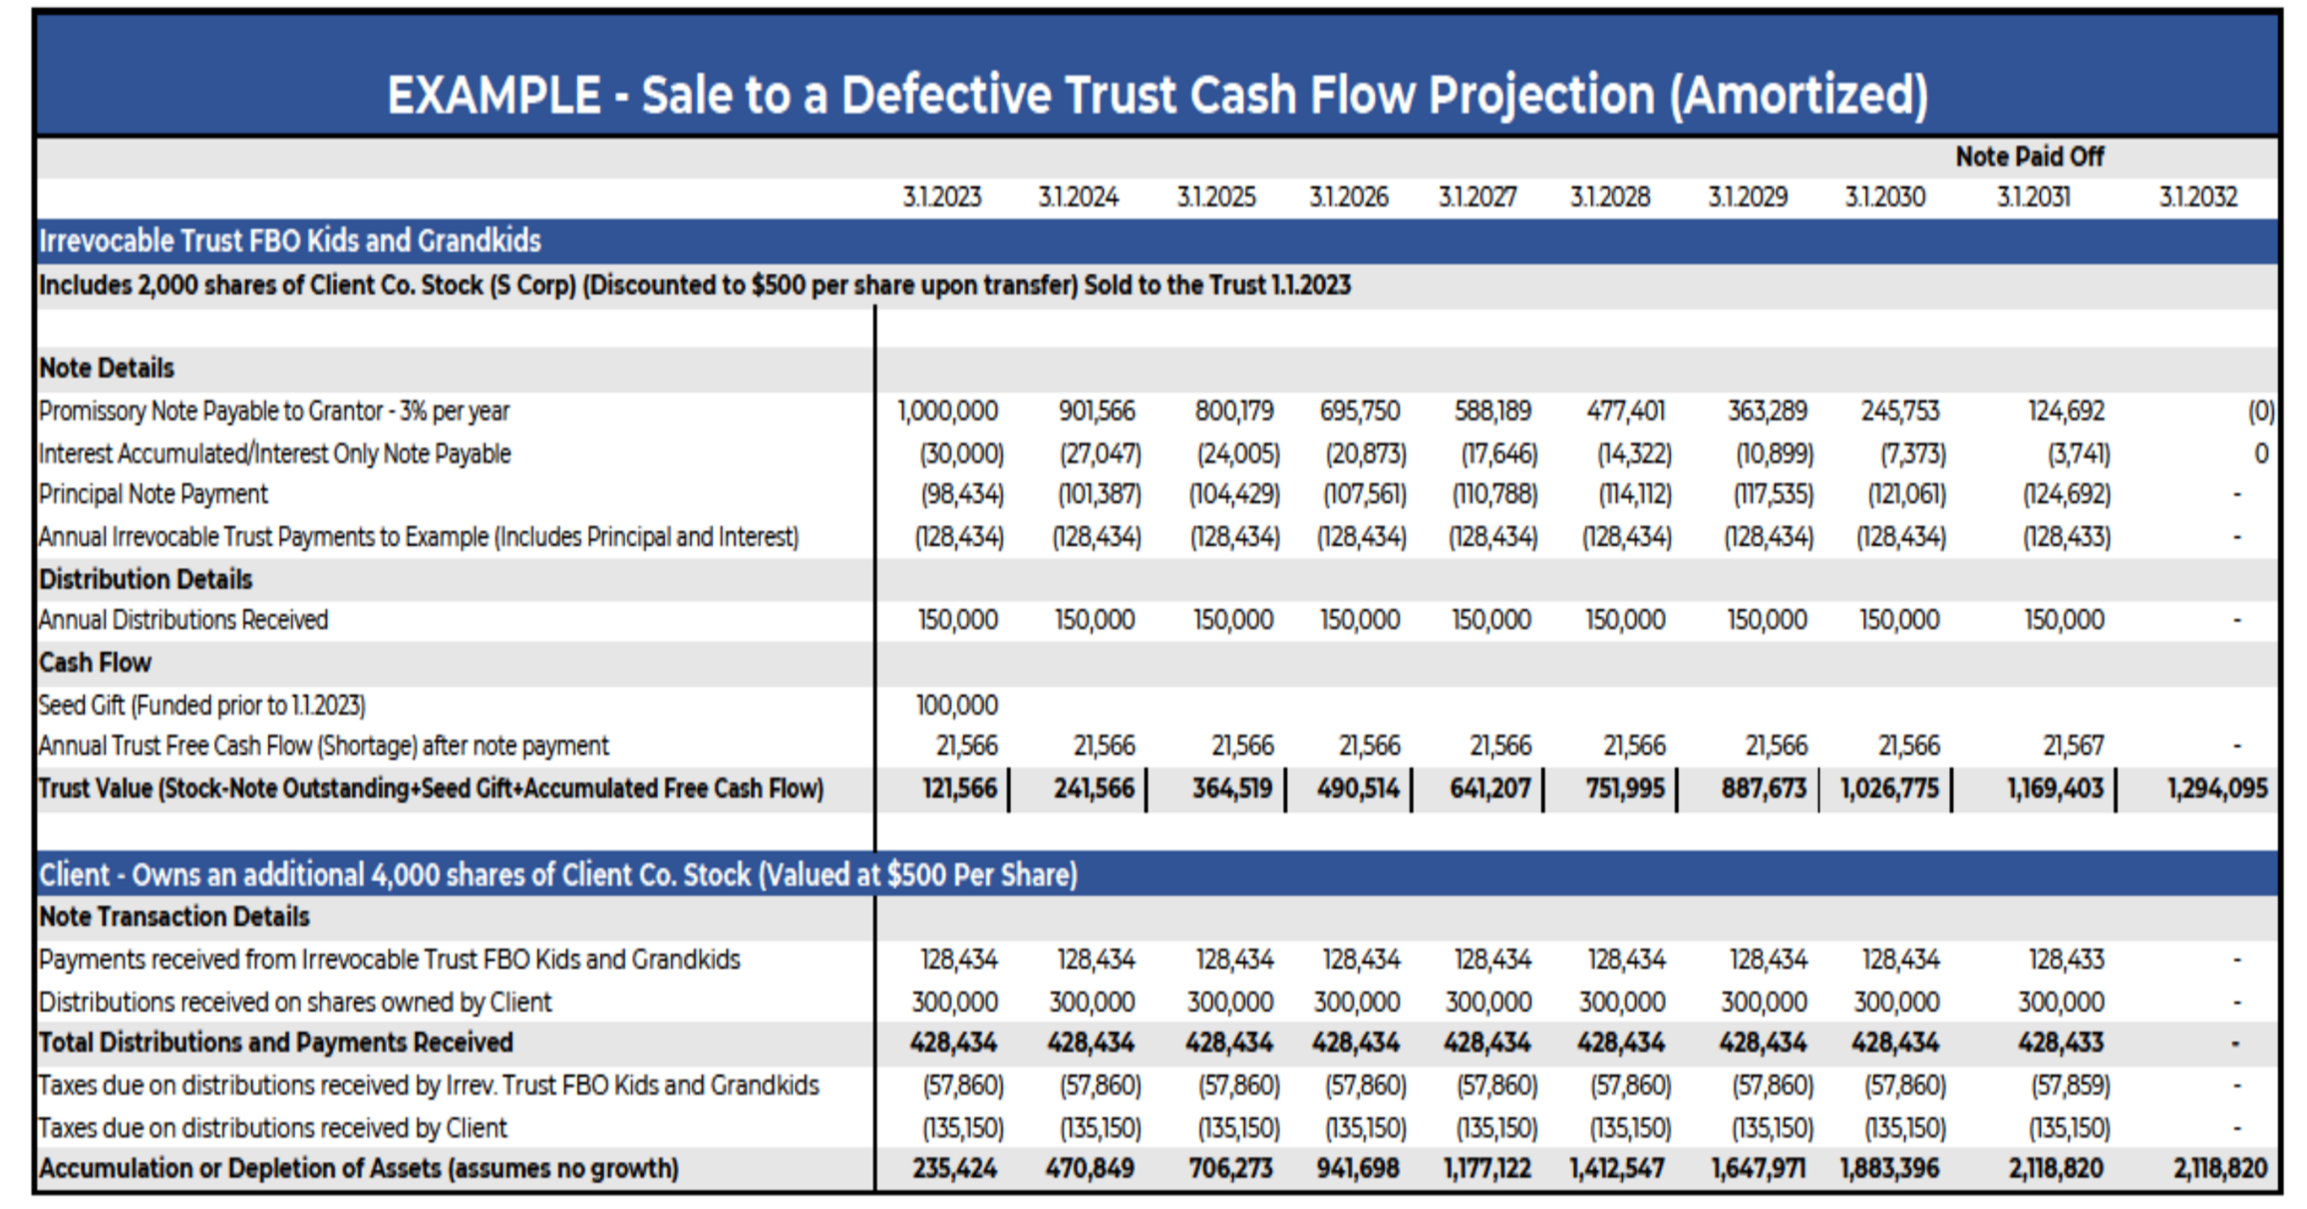
Notes:
Mark

Slide 30
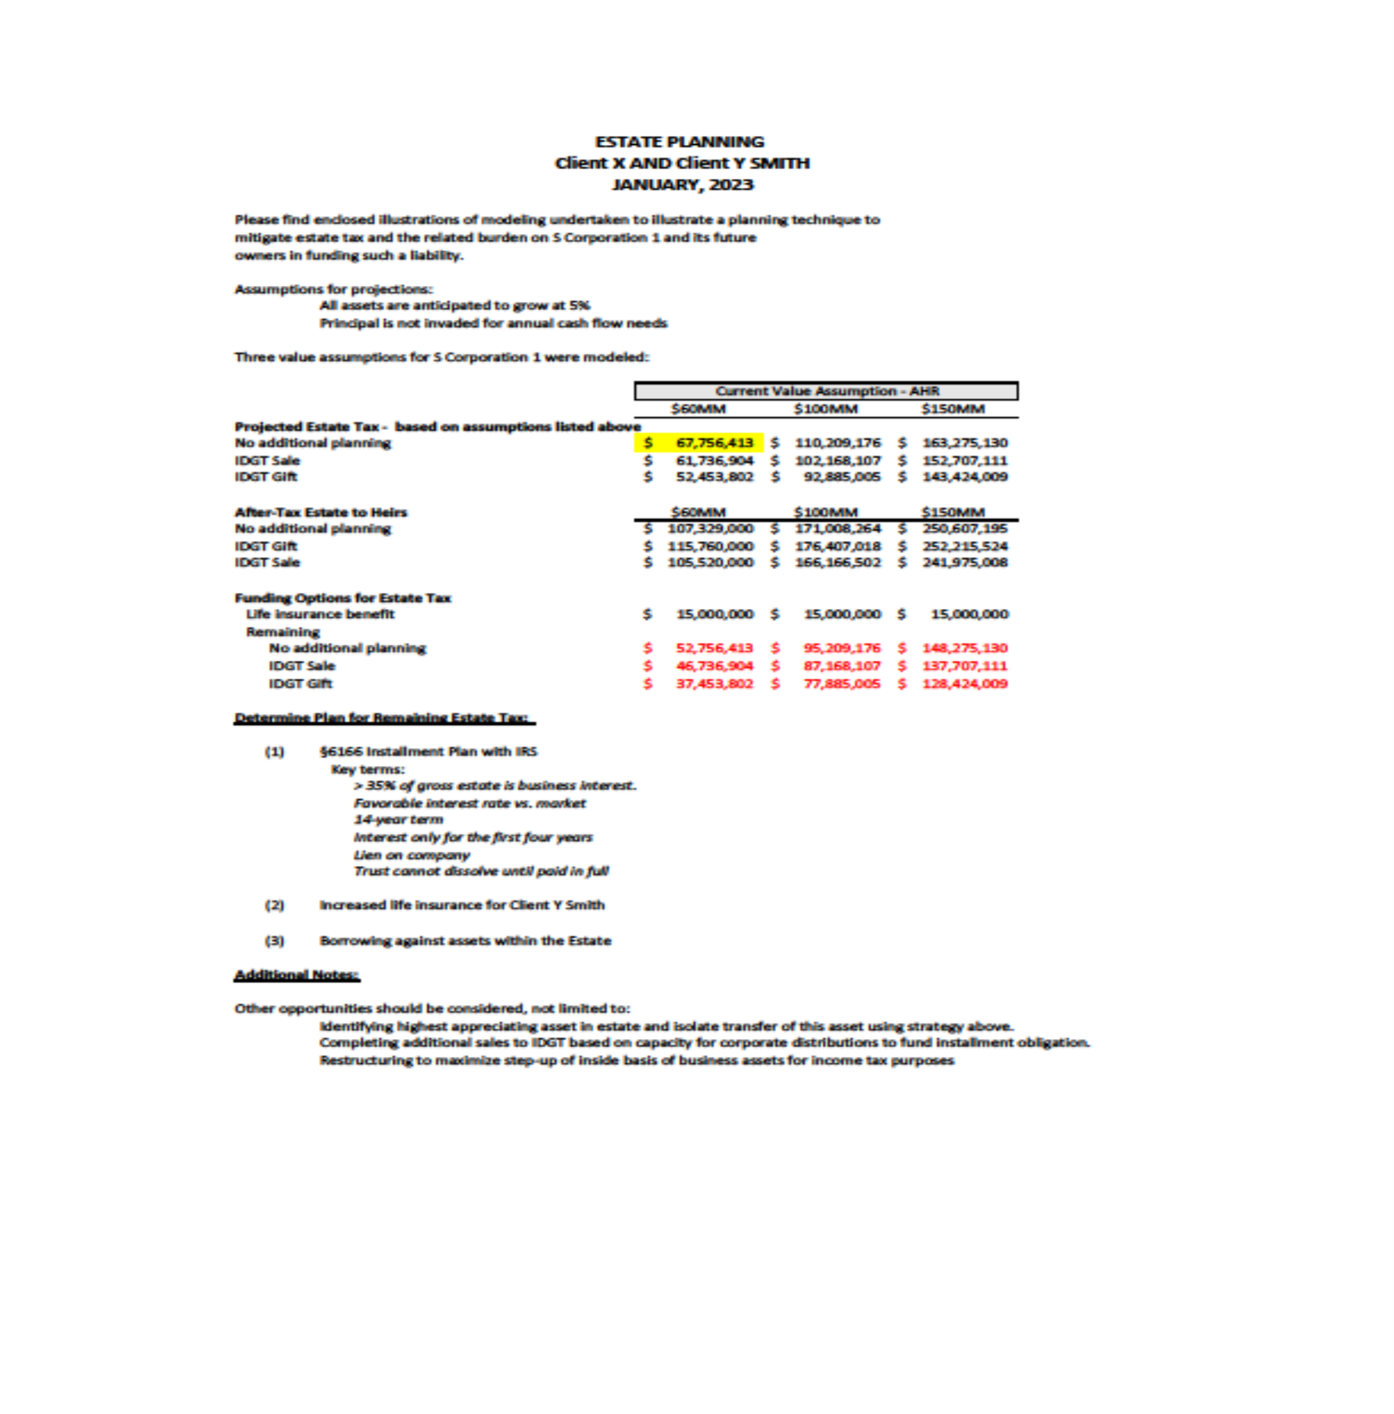
Plan for remaining estate tax
  Borrow – Section 6166 or privately through banks
    35% of gross estate is business interests, defer estate tax for up to 14 years
    Interest only for the first four years. Lien on the company
  Increase life insurance
  Sell assets/sinking fund
Notes:
Mark

Slide 31
Example 3: Estate plan for client with little to no liquid assets
QUESTIONS
Notes:
Mark and Cathy example :
Talk about ILIT strategy, 6166,

Slide 32
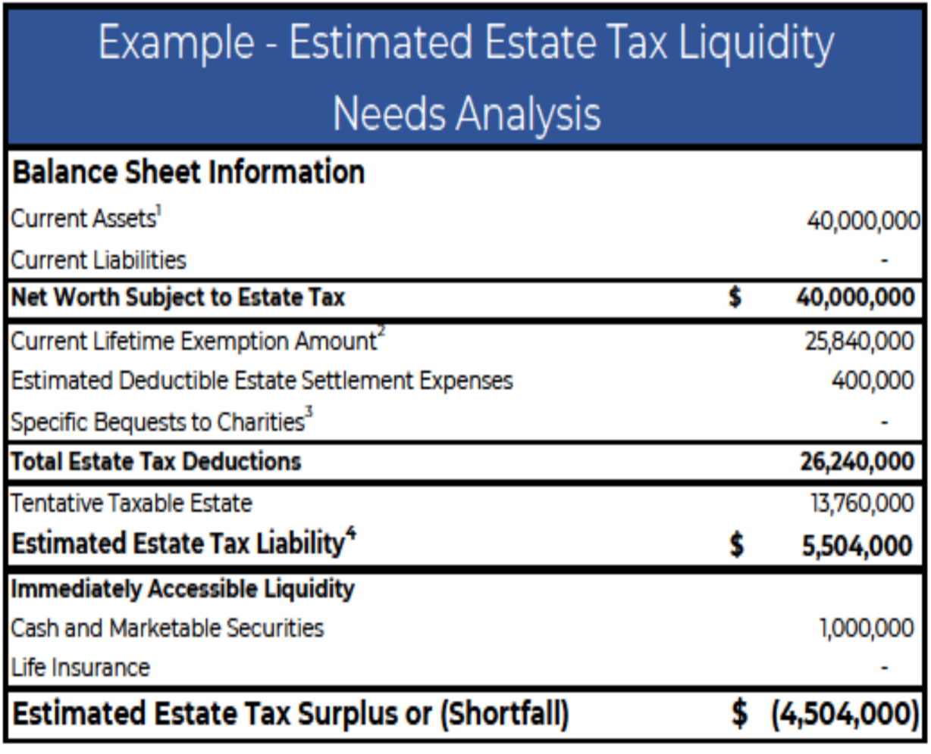
Example Profile
Married clients – both age 60
Invested in real estate and closely held businesses. Minimal cash on hand.
In order to pay estate tax, would either need to borrow against business/real estate or sell.
Priorities
  Estate Tax Mitigation
  Create liquidity to provide for estate tax liability
Notes:
Mark – Cathy I checked the workbook and didn’t see a liquidity needs analysis like this one. Please let me know if I’m off base or if you would like us to show something else here.

Slide 33
Solution:
Irrevocable Life Insurance Trust (ILIT)
What is it?
  An irrevocable trust that is designed to be the owner and beneficiary of a life insurance policy. The trust controls the management and distribution of the life insurance proceeds.
  Typically designed as a Crummey trust. Insurance policy premiums are commonly funded with annual exclusion gifts. They may, however, also be funded through loans in private split dollar arrangements, or by cash generated by other assets owned within the trust.
  Often used to provide liquidity to an estate. This liquidity may ultimately be used to pay estate taxes, or equalize the inheritances among a group of beneficiaries.
Notes:
Mark

Slide 34
* Watch out for “Unholy trinity” or “Goodman trap”.
** Be mindful of transfer for value rules
GRANTOR(S)
Determines the terms of the ILIT and selects Trustee(s).
Policy is transferred into or purchased by the ILIT
ILIT
Policy(ies) are owned by and pay to the ILIT
Policy(ies) may insure one person or two.
Multiple policies may be owned by the same trust.
Trust provisions control the management / distribution of insurance policy proceeds.
GIFT / Estate Tax
INCOME TAX
Considerations
The policy death benefit will be includable in the grantor’s taxable estate if they don’t survive three years from the transfer date
A form 712 may be requested from the insurance company to determine gift value of a policy
Notes:
Mark
Assets gifted in excess of annual exclusion amounts (if designed as a Crummey trust) will reduce remaining lifetime exemption (if any) and should be recorded on a form 709.
Cathy to add discussion here on annual exclusion gifts (how much you really get)
GST Exemption may be allocated
Typically, no income to tax if an insurance policy is the only asset of the trust.
If the discretion to apply or use trust income to pay premiums on insurance on the life of the grantor or the grantor’s spouse exists, it is a grantor trust.
Depending upon the transaction being considered, carefully review case law before relying on this provision.

Slide 35
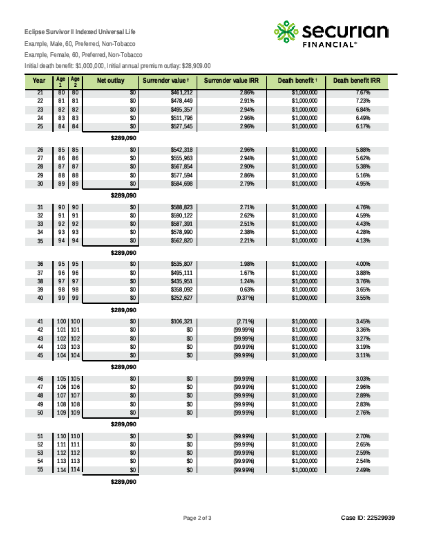
Example Facts
Policy death benefit is paid at the last to die of the insureds
10 annual premiums of $28,909 to guarantee policy for life.
4% after-tax IRR on death benefit at age 95 for both individuals
Notes:
Mark

Slide 36
KEEP ESTATE PLANNING TOP OF MIND FOR CLIENTS
QUESTIONS
Notes:
Mark and Cathy to wrap up

Slide 37
Tools
MyRehmann Tools coming soon….
Annual agenda that includes estate planning needs and any family or life changes that we should be aware of
Direct clients to our web content (articles, blogs, videos)
Bring in or consult with a team specialist
Keith Harder offers Securities through Rehmann Financial Network, member FINRA/SIPC.
Investment advisory services offered through Rehmann Wealth, a Registered Investment Advisor.
Insurance Services offered through Rehmann Insurance Group.
Notes:
Mark – if time..

Slide 38
Questions?
QUESTIONS

