Slide 1
Vulnerable adult definition MCL 750.145m
(u) “Vulnerable adult” means 1 or more of the following:
(i) An individual age 18 or over who, because of age, developmental disability, mental illness, or physical disability requires supervision or personal care or lacks the personal and social skills required to live independently.
(ii) An adult as defined in section 3(1)(b) of the adult foster care facility licensing act, MCL 400.703.

Slide 2
Vulnerable Adult Fraud
Financial Exploitation:
An action involving the misuse of an adult’s funds, property or personal dignity by another person.
Cognitive impairment diminishes the ability of older adults to make financial decisions.
Physical and cognitive impairment forces older adults to depend and trust others to handle their financial affairs.

Slide 3
Financial Exploitation 2005-2013

Slide 4
Elder Financial Abuse is Increasing
70% of personal wealth in US held by older adults (Met Life 2009)
Persons 65 and older hold $15 trillion in assets (Glaciel, 2009)
Losses exceed $2.9 billion annually (Met Life, 2011)

Slide 5
I.R.S. Scam
Notes:
May also be a recorded message advising that you are being sued by the IRS. Also someone files under your name before you file and obtains your refund.

Slide 6
FAMILY EMERGENCY SCAM

Slide 7
LOTTERY/SWEEPSTAKES SCAM

Slide 8
HOME REPAIR SCAM

Slide 9
LOVE INTEREST/FRIENDSHIP SCAM

Slide 10
HEALTHCARE/HEALTH INSURANCE FRAUD SCAM
Medical Equipment Fraud: Equipment manufacturers offer free products to individuals. Insurers are then charged for products that were not needed and/or may not have been delivered
“Rolling Lab” Schemes: Unnecessary and sometimes fake tests are given to individuals at health clubs, retirement homes, or shopping malls and billed to insurance companies or Medicare

Slide 11
Medicare Fraud: Senior citizens are frequent targets of Medicare schemes, especially by medical equipment manufacturers who offer seniors free medical products in exchange for their Medicare numbers. Con artists fake doctors signatures or bribe corrupt doctors to sign the forms. Once a signature is in place, the manufactures bill Medicare for merchandise or services that was not needed or was ordered

Slide 12
IDENTITY THEFT

Slide 13
CHARITY SCAMS
Scammers posing as charity workers contact seniors and offer up a sad story which, of course, concludes with a plea for funding

Slide 14
SCAREWARE

Slide 15
CARD CRACKING
You see a post on a social media site announcing a contest, or a gift card giveaway
At some point, you’re asked for your bank account information, PIN number, or online banking credential
Once card crackers have access to your account, they deposit multiple phony checks – usually remotely – and then make quick ATM or money order withdrawals
The goal is to get the cash before the bank figures out the checks are phony

Slide 16
JURY DUTY SCAM
You receive a call from someone who is supposedly at the courthouse
They claim that you have failed to report for jury duty and a warrant has been issued for your arrest
You’re then offered a choice to either pay for the warrant or have an officer sent over to arrest you. The fraudsters will typically demand that the money be paid by money transfer or by loading a prepaid card

Slide 17
UTILITY SCAM
This is a fear based scam that involves convincing you that the utility company is about to cut off service due to unpaid bills
The scammers will want money sent to them by money transfer or prepaid card

Slide 18
DEBT COLLECTOR SCAM

Slide 19
TELEMARKETING FRAUD
Notes:
Can either be soft spoken or pushy and rude.

Slide 20
Exploitation (by family and Caregivers)
Notes:
Heartbreaking! Done by people the victim depends on and loves.

Slide 21
New POA Law
MCL 700.5501. Effective May 22, 2012
Requires the agent to acknowledge the following limitations:
Act as a fiduciary
Follow principals instructions
Provide an accounting upon request
Keep the principal informed
Failure to print the language in an agreement does not erase the criminal activity.

Slide 22
Common Practices by Abusers
Obtain Power of Attorney
Obtain a joint bank account with victim (victim places money into account, abuser removes money)
Obtains a Quit Claim Deed to property
Uses victims credit cards/ debit cards without permission
Obtains credit/ property in victim’s name
Steals victim’s personal property or medications
Notes:
Steals personal belongings, vehicles and real estate.

Slide 23
Tips
Don’t let one person control the money. Have an objective third party look over financial statements.
Limit paid helpers. Consider providing a caregiver a monthly, pre-paid card to pay for groceries, etc. The card will track spending.
Refresh powers of attorney with the new “best interest clause”. Refresh the Durable Power of Attorney to include the mandatory promise to act only in the best interest of the vulnerable adult.

Slide 24
The Criminal Justice Process
Police/ A.P.S. is contacted. Investigation is conducted.
If evidence supports a charge, case is sent to Prosecutor. Prosecutor issues or denies a warrant.
Abuser is arrested.
Plea agreement or court hearing

Slide 25
Referral information
Better Business Bureau, www.bbb.org (703) 207-0100
Federal Trade Commission, www.ftc.gov (202) 326-2222
Credit report, www.annualcreditreport.com 1-800-525-6285, 1-888-397-3742, 1-800-680-7289
Michigan Department of Regulatory Affairs (L.A.R.A.) www.michigan.gov/lara
Michigan Attorney General, www.michigan.gov/ag (517) 373-1110
Adult Protective Services Hotline, (855) 444-3911

Slide 26
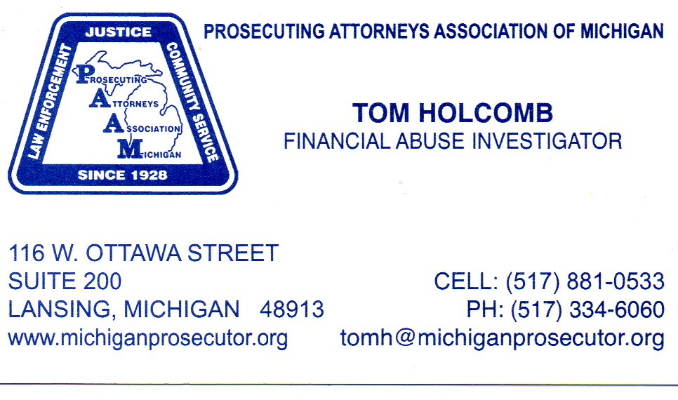

Slide 27
MI-MVP
Michigan Model Vulnerable Adult Protocol
Created by Department of Health and Human Services in 2013.
Protocol created after several elder abuse laws passed in 2012 (PA 175).
Adapted at the local level. 34 counties as of 10/20/15.
Notes:
May 2015
Adult – 18 yrs of age and older
Partners: Prosecuting Attorney, Midland Police and Sheriff, Public Guardian, DHHS, CMH, local Physician, Financial Institution, Veteran’s, Shelterhouse, Health Dept
Case review will involve those actually working with vulnerable adults
Education that is already done by police department

Slide 28
Vulnerable Adult Network
Midland County – MCVAN
Started February 2015. First Group meeting May 2015.
Community Partners
Prosecuting Attorney, Midland Police & Sheriff, DHHS, Senior Services, Public Guardian, CMH, MMMC, Financial Institution, Shelterhouse, Health Department, The ARC and others.
Notes:
May 2015
Adult – 18 yrs of age and older
Partners: Prosecuting Attorney, Midland Police and Sheriff, Public Guardian, DHHS, CMH, local Physician, Financial Institution, Veteran’s, Shelterhouse, Health Dept
Case review will involve those actually working with vulnerable adults
Education that is already done by police department

Slide 29
Vulnerable Adult Network
Vulnerable Adult – 18 years and older who is unable to protect him/herself from abuse, neglect or exploitation because of mental or physical impairment or advanced age.
Agreement (Protocol) Adopted Oct 2015
Monthly meetings – case review & business
Education -- general public and professionals

Slide 30
Investigative Team
Coordinate thorough and objective investigations.
Act within an appropriate response time.
Minimize victim trauma.
Respect rights of alleged perpetrator.
Feedback to partner agencies.

Slide 31
Agreement - Purpose
Protect & serve, conduct coordinated & efficient investigations.
Increase our understanding of the complex issues surrounding abuse or neglect.
Enhance understanding of the role each partner agency has during investigation, minimize duplicate efforts.
Commit to conducting case review to help determine most effective manner to assist in the investigation, help identify the needs of and provide services, including wellness checks and monitoring.
Honor rights of vulnerable adults to make own decisions.

Slide 32
Reporting
Michigan Centralized Intake
for Abuse and Neglect
(855) 444-3911

