Slide 1
2020: Racing to the Finish
Northeastern Michigan Estate Planning Council
October 22, 2020

Slide 2

Planning for the Tax Sunset

Slide 3
2020: A Unique Point In Time
Low Interest Rates
Tax Law Sunset
Favorable Tax Laws

Slide 4
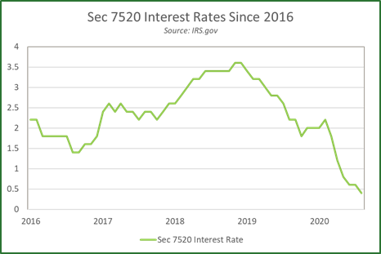
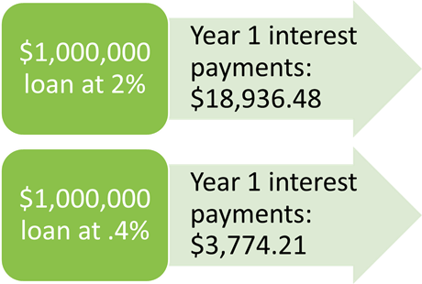

Slide 5
What Happens After Sunset?
A person passes with a $10,000,000 estate
December 31, 2025: Likely pays $0 estate tax
January 1, 2026: Likely pays $1,600,000 in federal estate taxes*
A person does a Roth conversion for a $500,000 IRA
December 31, 2025: Likely pays $185,000 in income taxes at the highest marginal rate
January 1, 2026: Likely pays $198,000 in income taxes at the highest marginal rate
*Assumes a projected exemption of $6,000,000 and an estate tax rate of 40%

Slide 6
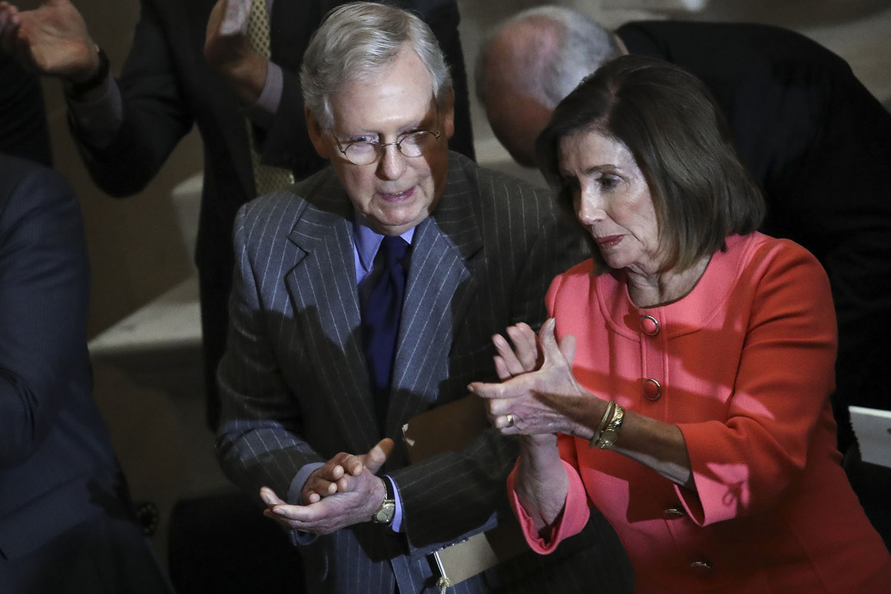
Could the Sun Set Sooner?
  The increase in government spending associated with the COVID Crises, combined with various potential election outcomes, have many commentators suggesting that higher tax rates could come earlier than 2025.
  Under the current estate tax law, only about 30 of the 535 members of Congress would be subject to estate tax under the current exemption amount.
  After sunset occurs, that number likely jumps to just over 70 of the 535.
  Some Democratic proposals would re-set the exemption to $3.5m, potentially subjecting more than one-third (or about 180) of the 535 to estate tax.
*Figures on Congressional net worth provided by the Center for Responsive Politics

Slide 7
Business Owners
This may not be the best time to make a gift of a closely held business, due to valuation – patience might pay off
Is this a good time to re-negotiate intra-family loans?
  Old loans might have higher interest rates
  You might be able to renegotiate those loans at a lower rate, or move them to commercial structures
The same might be true for Grantor Trust Arrangements
  Should you use the swap power to pull assets out of an Intentionally Defective Grantor Trust (IDGT) and substitute them for cash or securities?
  This can be a great step-up in basis play for older clients

Slide 8
Grantor Retained Annuity Trusts
GRATs are a great way to move property from one generation to the next without triggering gift or estate tax
Clients who may be well suited for a GRAT:
  People subject to estate tax; or who MIGHT be subject to estate tax after sunset
  People with non-IRA marketable security portfolios; be sure to look for market dips for funding
  Business owners who expect significant appreciation in the near future (i.e. a potential sale or introduction of a new product)
Step 1
Parent funds a 5 year GRAT with $1,000,000
Step 2
Parent receives 5 annual payments of $202,400 (calculated using the 7520 Rate of .4%)
Step 3
If the GRAT assets annually produce 2% in interest, and grow at 5%, $240,700 is transferred to the children tax-free

Slide 9
Example:
Type of Calculation: | Term
Transfer Date: | 8/2020
§ 7520 Rate: | 0.4%
Income earned by Trust: | 1.8%
Term: | 2
Total Number of Payments: | 2
Annual Growth of Principal: | 6 %
Pre-discounted FMV: | $5,000,000
Percentage Payout: | 50.299 %
Annual Annuity Payout: | $2,514,964
Value of Term Certain Annuity Interest: | $5,000,000
Taxable Gift | $0
Economic Schedule
Year | Beginning Principal | 6.00% Growth | 1.80% Annual Income | Required Payments | Dtributed Discount | Remainder
1 | $5,000,000.00 |  |  | $2,514,964.00 | $0.00 | $4,459,748.00
2 | $2,877,736.00 |  |  | $2,514,964.00 | $0.00 | $3,863,914.87
Summary | $5,000,000.00 | $472,664.16 | $146,053.23 | $5,029,923.00 | $0.00 | $588,789.39

Slide 10
Sales to Grantor Trusts
Nuts and Bolts: Mom wants to transfer closely held business interest to son.
Step 1: Mom creates a Trust
  Mom is the grantor for tax purposes (so she pays all of the income taxes)
  The son is the beneficiary
  Huntington is the Trustee
Step 2: Mom makes a gift of $100,000 into the trust
Step 3: The Trustee uses the cash to buy the stock in the business
  $100,000 in cash to Mom,
  A note to Mom for $900,000, with interest at a 7520 rate
Step 4: Every year the business pushes out dividends into the trust which are used to pay the note
The lower the 7520 rate, the lower the imputed interest

Slide 11
What to Avoid
Qualified Personal Residence Trusts (QPRTs) – lower rates equate to a higher taxable gift to the next generation
Charitable Remainder Annuity Trusts (CRATs)
  Client funds a trust provides a fixed income amount for life, remainder to charity
  70 year old donor funds a $100,000 trust paying $6,000 annually
  6% 7520 rate = deduction of $46,859
  2.2% 7520 rate = deduction of $29,431…which flunks the 5% rule!
  In fact, someone who is 70 years old isn’t permitted to do a CRAT under the current rules!

Slide 12
What to Avoid, con’t
Charitable Gift Annuities (CGAs)
  An irrevocable lump sum is gifted to a qualified charity
  In exchange, a fixed annualized payment is given back in return
  Charitable deduction for the remainder
  Low interest rates = lower monthly payments, AND a lower initial income tax deduction
Practice Point: If a client currently has an existing CRAT or CGA, this might be a good time to donate the remainder interest to the charity

Slide 13
Contact Information:
Daniel R. Griffith, JD
SVP, Director of Wealth Strategy
Huntington Private Bank
Email: Daniel.R.Griffith@huntington.com
Phone: (330) 258-2379
Questions?
Disclosure lore ipsum

Slide 14
This publication contains general information. The views and strategies described may not be suitable for all investors.
Any forecasts presented are for illustrative purposes only and are not to be relied upon as advice or interpreted as a recommendation. Individuals should consult with their investment adviser regarding their particular circumstances. This material has been prepared for informational purposes only, and is not intended to provide, and should not be relied on for, accounting, legal or tax advice. Contents herein have been compiled or derived in part from sources believed reliable and contain information and opinions that are accurate and complete. However, Huntington is not responsible for those sources and makes no representation or warranty, express or implied, in respect thereof, and takes no responsibility for any errors and omissions. The opinions, estimates and projections contained herein are as of the date of this publication and are subject to change without notice. This material is not intended as an offer or solicitation for the purchase or sale of any financial instrument. Investing in securities involves risk, including possible loss of principal amount invested. Past performance is no guarantee of future results.
Huntington Private Bank® is a team of professionals dedicated to delivering a full range of wealth and financial services.
The team is comprised of Private Bankers, who offer premium banking solutions, Wealth and Investments Management professionals, who provide, among other services, trust and estate administration and portfolio management from The Huntington National Bank, and licensed investment representatives of The Huntington Investment Company, who offers securities and investment advisory services. Huntington Private Bank® is a federally registered service mark of Huntington Bancshares Incorporated.
The Huntington Investment Company, is a registered broker dealer, member FINRA/SIPC, and a registered investment adviser with the U.S. Securities and Exchange Commission (SEC). The Huntington Investment Company is a wholly-owned subsidiary of Huntington Bancshares Incorporated.
Insurance products are offered by Huntington Insurance, a subsidiary of Huntington Bancshares Incorporated and underwritten by third party insurance carriers not affiliate with Huntington Insurance.
Trust and investment management services are provided by The Huntington National Bank, a national bank with fiduciary powers. The Huntington National Bank is a wholly-owned subsidiary of Huntington Bancshares Incorporated.
Investment, Insurance and Non – Deposit Trust products are: NOT A DEPOSIT • NOT FDIC INSURED • NOT GUARANTEED BY THE BANK • NOT INSURED BY ANY FEDERAL GOVERNMENT AGENCY • MAY LOSE VALUE
The Huntington National Bank is an Equal Housing Lender and Member FDIC. ®, Huntington®, Huntington®
and Huntington Private Bank® are federally registered service marks of Huntington Bancshares Incorporated.
©2020 Huntington Bancshares Incorporated.

