Slide 1
EFFECTIVE CONFRONTATION: The Three moves

Slide 2
Knowing that this session is about learning confrontation skills…
What is your goal for this session?
What can you do to ensure this time is valuable?
Notes:
Since we won’t have much pair share or group discussion, want to give participants a chance to do some self-reflecting around what their goal is for this session and what they want to get out of it.

Slide 3
VISION
We imagine a society where leaders have the skills and courage to care.
MISSION
We offer transformational learning experiences that strengthen relationships, align teams, and build stronger communities.
Leadership Philosophy
Everyone has the capacity for leadership
Leadership impacts all aspects of life – family, workplace, & community
Leadership is a privilege and a profound responsibility
Notes:
Facilitator notes:
This slide should just be used as a very high level overview of who we are and what we do.
Emphasis is on the compelling piece of imaging a world where everybody feels as they matter and are cared for … even in challenging conversations.
Throughout this training, you will have the chance to do three things: consider your own difficult yet needed conversations, learn skills to have them, consider how to model those skills to others within your school

Slide 4
Think back to a time recently when you were bugged by someone’s behavior
How did you respond?
Notes:
Give participants three minutes to reflect

Slide 5
How did you respond to someone when their behavior bugged you?
Notes:
Transition: One of the things that we teach in Our Community Listens is that any time we are bugged – no matter how big the problem or how important the relationship – we always have three moves

Slide 6
Three Moves
Accept the Behavior
Adjust the Circumstances
Ask for Change
I change to see that which originally upset me as something I can now accept
I change the situation by removing what originally upset me from the scene
I confront someone with the facts and feelings of my problem and ask for change
I CHANGE
I CONFRONT
Notes:
Animation within slide
Read and explain the three choices using a simple story to show how a person could apply all three choices in the same story.
Emphasize the need to avoid false acceptance.
The self-test on false acceptance is “are you saying one thing on the outside; yet having another conversation on the inside?” If so, that is false acceptance.
Emphasize that if you choose to confront, it’s critical to remember that confrontation is about asking others to change their behavior for you and this requires you think carefully and act wisely on your own behalf if the other is going to be willing to change their behavior for you.
Instruct participants to draw a line in between 2 and 3.
Ask participants with my first and second move, who is changing?
Answer: I change.
Animate slide
Ask participants with the third move, who is changing?
Answer: I am asking the other to change.
Transition: For the purpose of this session, let’s assume that you cannot accept the behavior and you do not want to adjust the circumstances, so you have decided to confront and ask for change.

Slide 7
Confrontation Defined
Confrontation is to face someone with the facts and feelings of my problem and ask for change.
Confrontation is simply a conversation starter.
Notes:
Facilitation Notes:
Read and explain the definition of confronting, emphasizing the need to approach people with both the facts and the feelings of their experience and a request that they change.
This is the heart of confrontation.
It is important to stress – this is simply a conversation starter.
Key Point:
A confrontation is to begin a dialogue of discovery and a request for help.

Slide 8
How to Confront
Check your motive
Craft your confrontation message
Send your confrontation message
Reflectively listen
Repeat as needed
Notes:
Animation within slide
Facilitation Notes:
When we choose to confront, these are the five steps we will take.
First, we must check our motive. Why are we confronting the other person? Is it to get back at them or make them feel small? Or is to build trust and strength to the relationship?
Second, we craft the message. Let’s spend some time exploring what we mean by crafting your confrontation message

Slide 9
Crafting Your Confrontation Message
Specific Behavior
Primary Feelings
Impact
Include three ingredients
FBI: Feelings, Behavior, Impact
The order is flexible
F
B
I
Confrontation
Message
Notes:
Explain the nature of a Confrontation Message: it is simply a conversation starter and contains three ingredients/elements.
The order of each element does not matter.
Inform them you will now give a deep dive of each element or ingredient of the Confrontation Message.

Slide 10
Ingredient 1
My Primary Feelings
Secondary Feelings
Afraid
Angry
Happy
Sad
Primary Feelings
Anxious
Concerned
Engaged
Frustrated
Grateful
Hurt
Inspired
Proud
Pressured
Stuck
Critical Question: What primary feelings am I experiencing from the other person's specific behavior?
Notes:
Explain the first element is primary feelings.
Answering the critical question helps the one confronting define what it is they are truly feeling.
Teach the idea that secondary feelings are those we commonly use without giving our feelings much thought.
Primary feelings are the deeper feelings that drive us to use secondary feeling words.
Primary feelings are the feelings we experience deep within our person. They are feeling words we rarely share with others.
All of our feelings, both primary and secondary, are driven by our known and unknown needs.

Slide 11
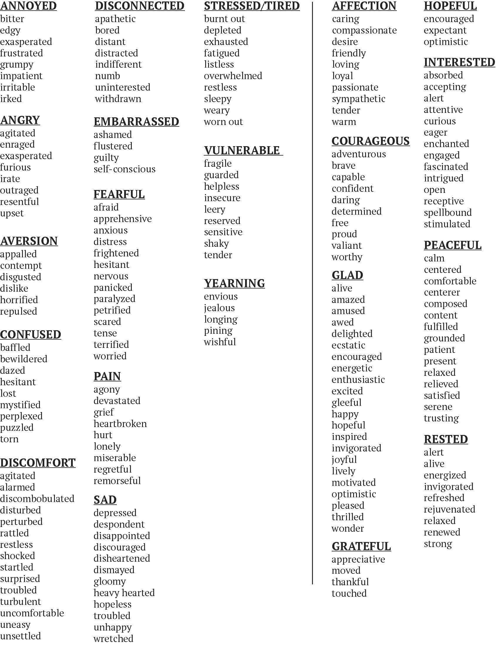
Feelings and Emotions
Angry
Agitated
Enraged
Exasperated
Furious
Irate
Outraged
Resentful
Upset
Notes:
Pass out (or drop in the chat) the Feelings and Emotions List
'Angry' is a feeling that can really be described in greater detail by using one of the emotions listed below. The more specific we can be with naming our emotions, the easier it is for people to understand us.

Slide 12
Ingredient 2 – Specific Behavior
Critical Question: What specific behavior is upsetting me?
Behavior can be seen, felt, or heard
“When you are late for work…”
“When your hours are not turned in on Friday...”
Notes:
Explain that the second element of a Confrontation Message is specific behavior.
Answering this critical question helps the one confronting define what the other is doing that bothers them.

Slide 13
Specific Behavior vs. Sticky Judgment
Judgments are opinions we form based on our perspectives and beliefs
We label others by attaching judgments to their behaviors
Often behaviors are wrapped in judgment statements
Lazy
Can you see the difference between objective behavior and subjective judgment?
Notes:
Read and explain that behaviors and judgments are not the same.
Explain that previously many of our confrontations failed because we did not address behavior, we simply judged the other.
It is critical participants realize judgment has no place in confrontation; it only clouds confrontation.

Slide 14
Ingredient 3 - Impact
Critical Question: What impact is the other person's specific behavior having on me, the team, or the organization?
Time
Energy
Money
Fulfillment
Notes:
Explain that the third element of a Confrontation Message is impact.
Answering this critical question helps the one confronting define the impact of the behavior of the other. Explain that impact typically takes the form of time, energy, money and fulfillment.
Provide examples and stories of each.
Time – “had to do the project over”, “others had to do the work”, “did not meet a deadline”, “had to take time to have this conversation”
Energy - “had to do the project over”, “others had to do the work”, “took focus away from”
Money – “went over budget”, “did not get the best price”, “need to spend in order to accomplish”
Fulfillment – “hard to have conversations together”, “makes me consider our relationship”, “don’t feel valued”

Slide 15
Completed Confrontation Message
The primary feeling(s)
The specific behavior
The impact(s)
“Pete, I am anxious; you have been late for work three times this week. It's affecting productivity and forcing the team to play 'catch up'.”
“Jim, I overheard you say, ‘Tim is incompetent’ to a customer. I’m concerned about what the customer thinks and how this reflects on our team.”
Notes:
Animation within slide
Animate and read slide to show how the three ingredients/elements combine to form a confrontation message.
Read and then ask participants to find each ingredient in both messages.
Prior to advancing to the next step, ensure participants can combine each ingredient to form a confrontation message of their own.

Slide 16
Think of a current problem you are having with someone
Identify the F.B.I.
Feelings
Behavior
Impact
Craft a confrontation message
Notes:
Read instructions to the class and allow them 3-5 minutes to craft their confrontation message.
If time allows, have participants do a pair share to get feedback or invite a couple participants from class to share them and audit them for accuracy.
When the message is incorrect, clarify the error.
Be mindful of loaded language embedded in their example and call out as needed.
Be mindful of judgments.
A quick check to determine if a statement is a behavior or a judgment is, “Do _____”—example, “Do lazy” does not make sense because lazy is not a behavior.

Slide 17
How to Confront
Check your motive
Craft your confrontation message
Send your confrontation message
Reflectively listen
Repeat as needed
Notes:
Now that the message has been crafted, you can move into steps 3-5
For those of you who have taken Our Community Listens, you know what it means to reflectively listen after you have sent your message. This is when you get to use your 5 reflective listening skills. If you haven’t taken Listens yet, you will learn more about this on Day 2. Either way, right after we confront someone, we have to be ready to listen to them – they are often filled with lots of emotion or might share things we hadn’t even considered yet.

Slide 18
Is there a situation in your life that could benefit from choosing to use one of the three moves?
What impact might confronting this way have on your relationships?

Slide 19
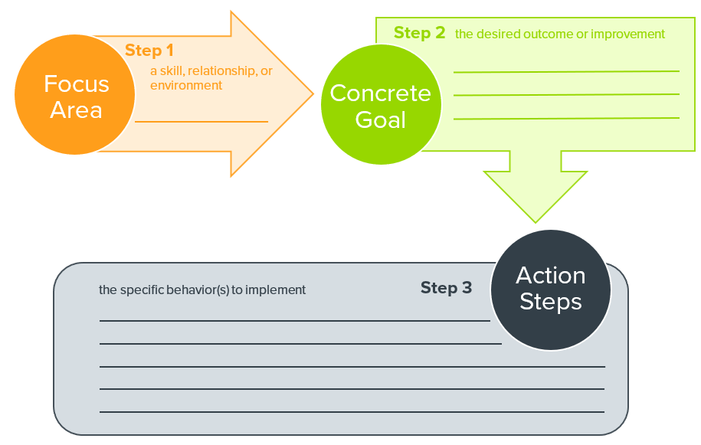
Personal Action Plan
What skills would you like to focus on?
What changes would you like to make?
Goal setting:
Focus Area – Skill, Relationship or Environment
Concrete Goal – Desired Outcome or Improvement
Action Steps – Specific Tactics to Implement
Notes:
This action plan is also part of Our Community Listens (and really any training that we offer
Explain the form—provide your own example--
Debrief if time and if anyone feels they want to share
Have participants reflect on their “aha!” moments during this session.
What are you willing to commit to doing differently tomorrow?
Remind them they have a much greater chance of success if they set a concrete goal. Inform them how the last portion of the hand-out can assist them in this process. Identify the focus area; set a concrete goal that can be measured in some way; identify the steps you will take to do this. Share an example if you have one.
Allow 5-7 minutes for participants to complete.

Slide 20
Sign up for Our Community Listens!
Implement your Action Plan
Consider relationships that will benefit from your new skills

